Slide 1

8th Grade Orientation
GHS Class of 2018

Slide 2
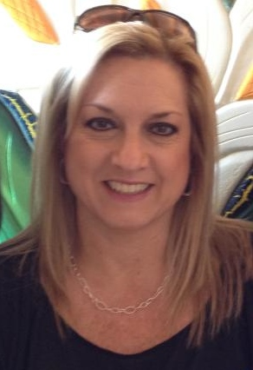

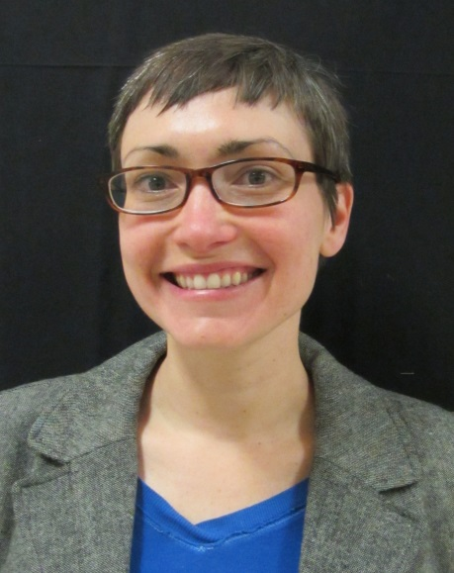
Meet Your School Counselors
Gibbs High School Counselors work with students by alphabet.
Mrs. Galyon works with
students
A-F
Mrs. Draper works with students
G-M
Mrs. Buchanan works with students
N-Z

Slide 3
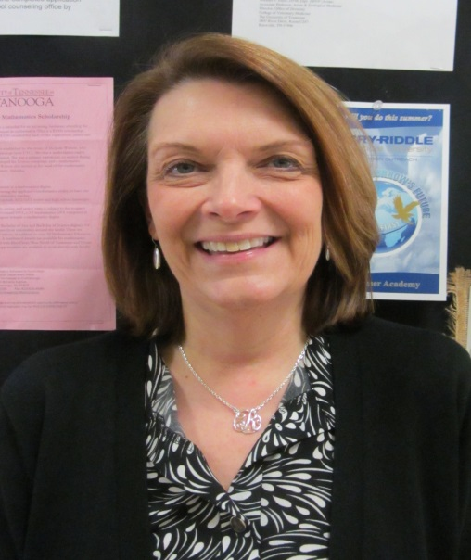
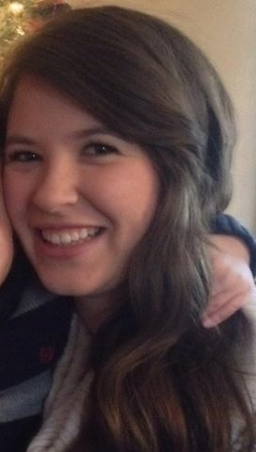
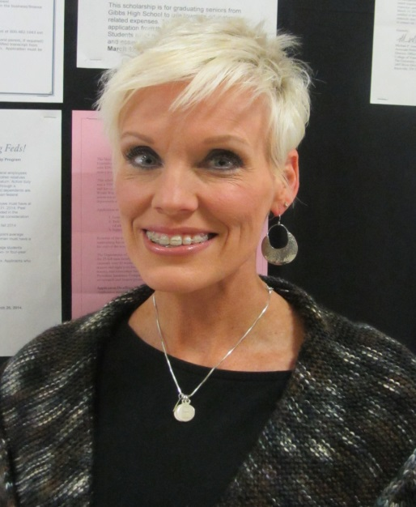
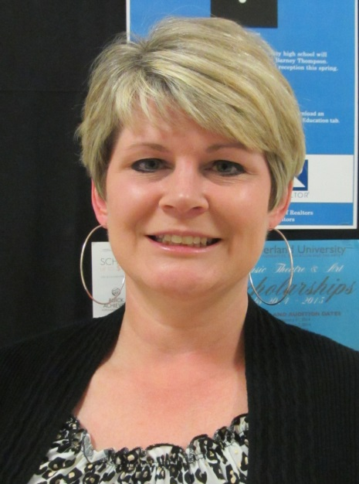
School Counseling Office Staff
Mrs. Hughes is our Graduation Coach
Mrs. Boggs is our School Climate Counselor
Mrs. Wright is our Registrar
Ms. Branam
is our Counseling Secretary

Slide 4
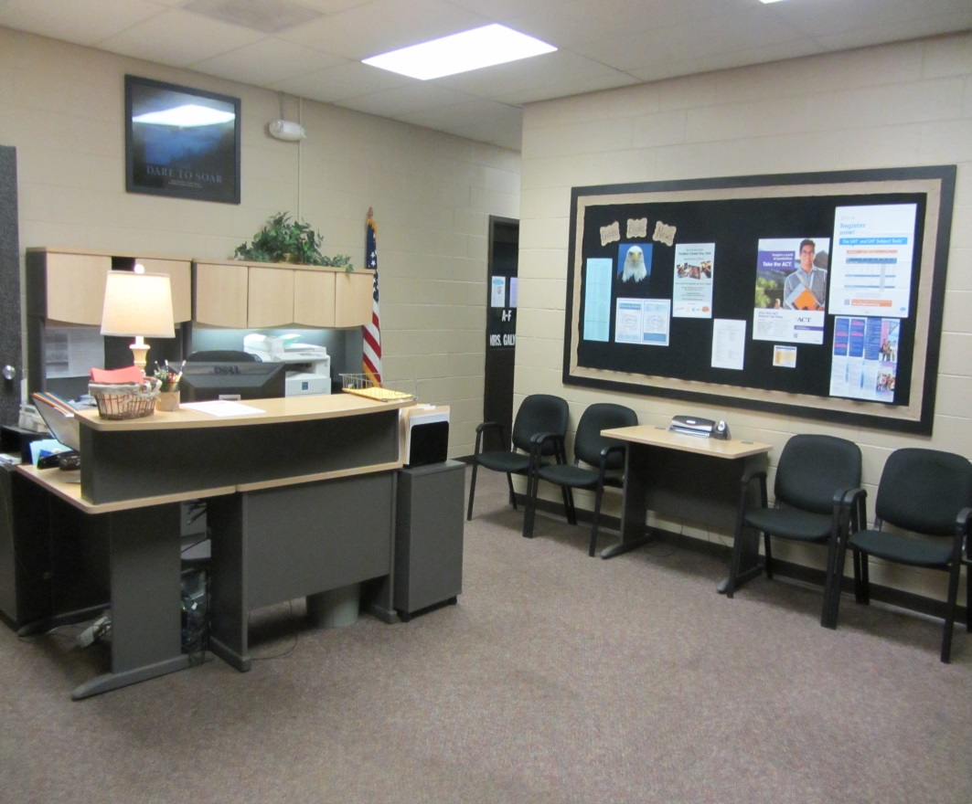
The School Counseling Office
School Counselors see students for a variety of reasons:
  Academics
  College/Career Planning
  Social or Emotional
  Today your school counselors will be talking to you about transitioning to and registering for high school.

Slide 5
Middle School vs. High School
Hallways are divided by grade level and wings.
Holston is one building and you travel to all classes inside the same building.
Middle school teachers can be more lenient with missing work. High school teachers expect you to be proactive about getting your work if you are out.
More Freedom!
  No Assigned Lunch Tables
  Teachers do not escort students to class
  Final Exams Instead of TCAPS
  You will have a final exam at the end of every class and it will count for 25% of your grade.
  Each course you pass will count as 1 credit. You need 28 credits to graduate.

Slide 6
High School Schedules
BLOCK SCHEDULING
2 Semesters Per Year
1st Semester is August-December
2nd Semester is January-May
4 - 90 minute classes per day

Slide 7

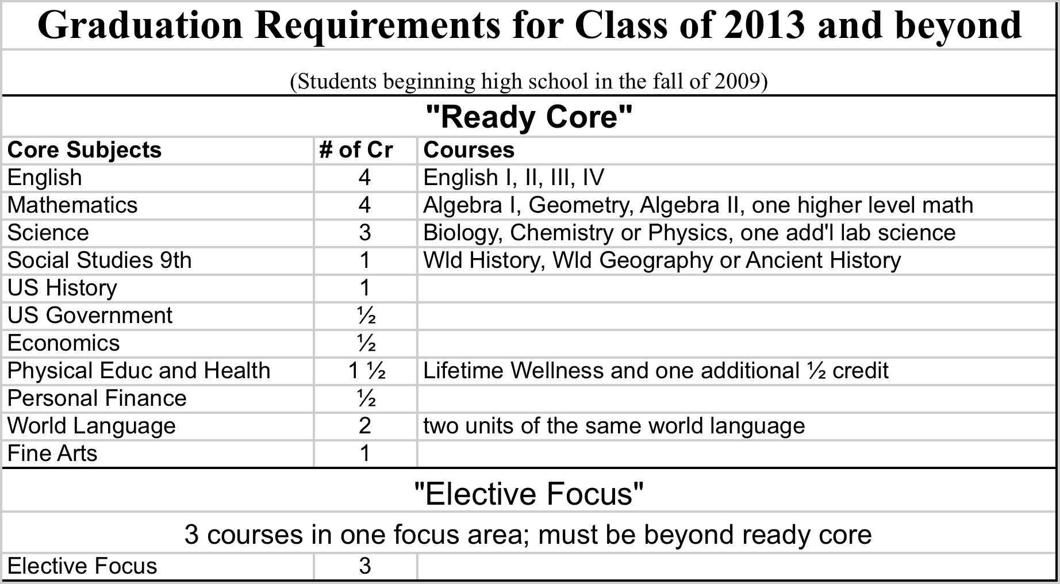
Graduation Requirements

Slide 8
Elective Focus
To meet graduation requirements, all students must complete an elective focus.
If you waive the university requirements (2 Foreign Language and 1 Fine Art) then you must complete 2 elective focus areas. One of them must be in CTE.
Refer to your packet for the elective focus options at Gibbs High.

Slide 9
High School Transcript
Your final grade for each course that you take will go on your transcript.
All four years of your high school grades will be on your transcript.
9th GRADE COUNTS!!!
Transcripts will be seen by college admissions departments, scholarship committees, etc.!
Your college admissions process begins now!!
Your progress towards graduation begins now!!

Slide 10
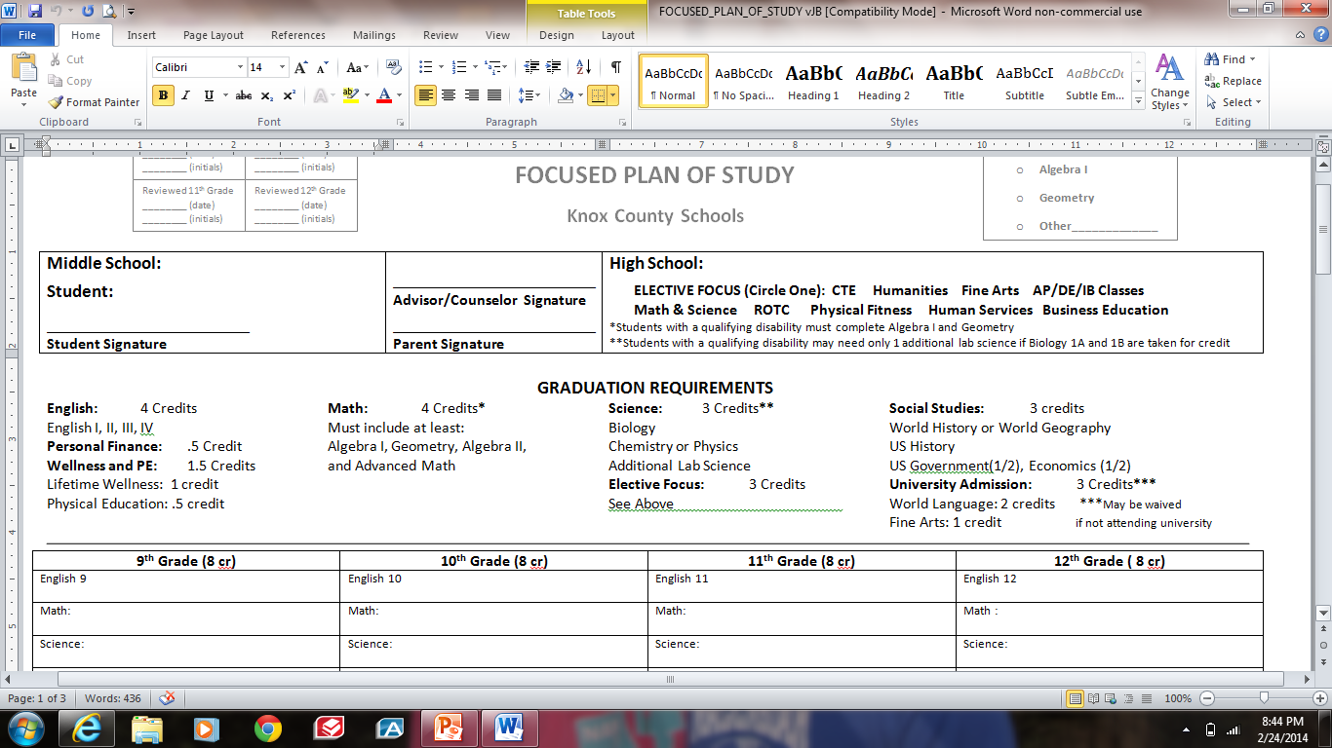
Focused Plan of Study

Slide 11
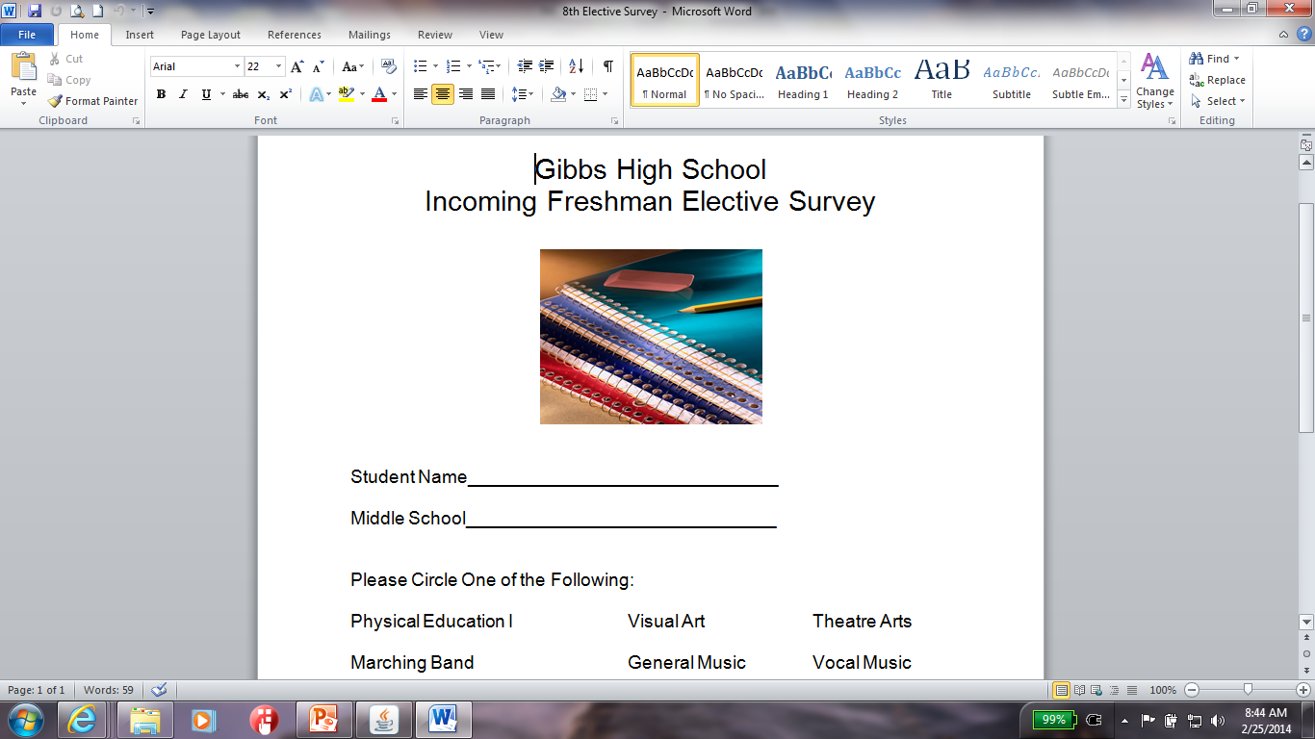
Elective Focus Survey
We need this back today!

Slide 12
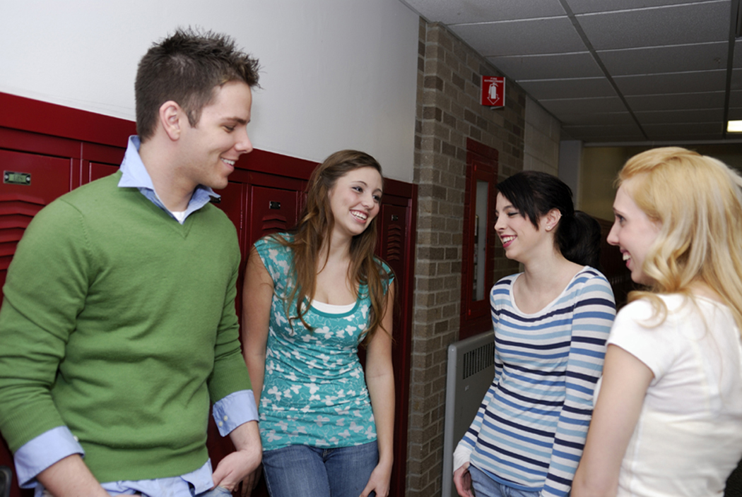
Advice from Current Freshmen
Get Involved! There is something for everyone!
Lunch is more fun – we love eating outside!
Study harder. The late work policies are more strict and the final exams count for 25% of your entire grade!
There are less fights in high school, students are more serious about school.

